Slide 1
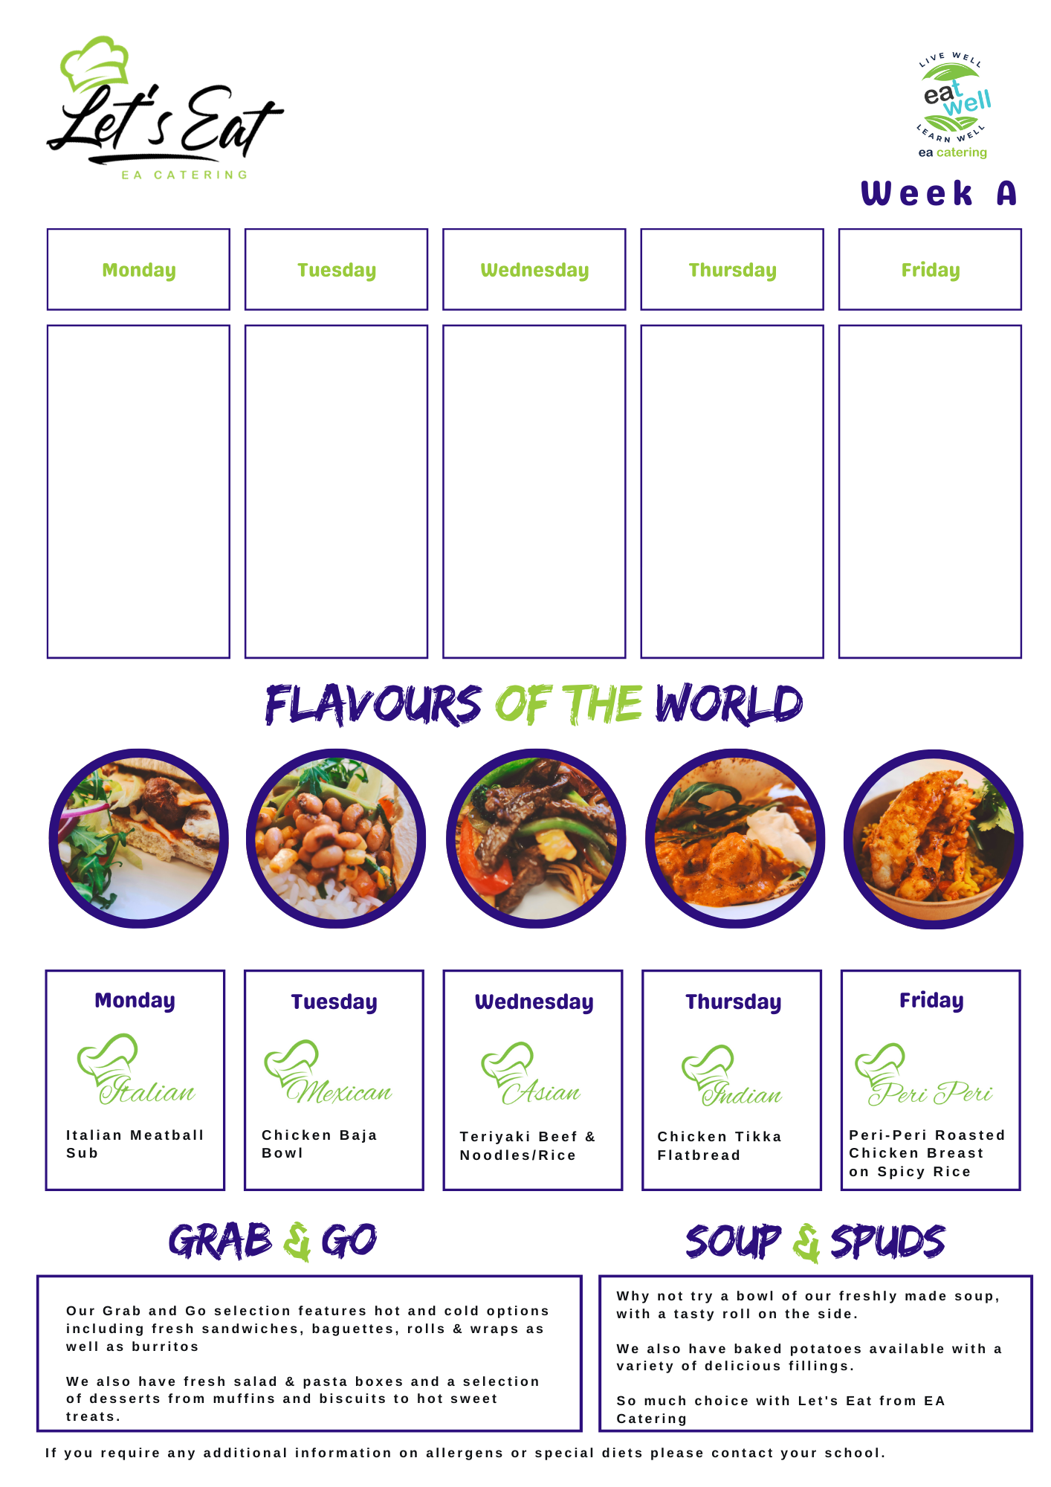
The hub week 3
Salted Chilli Chicken, oriental veg
Fried rice
Curry Sauce
Freshly made Tray bakes
Oven Roast Sausages
Mashed Potatoes
Baked Beans
freshly made Tray bakes
Chicken Goujons
Chips
Corn on the cob
freshly made Tray bakes
Creamy Chicken & Leek Pie
Chips
freshly made Tray bakes
Chicken Curry
Steamed Rice
Naan Bread
freshly made Tray bakes

Slide 2
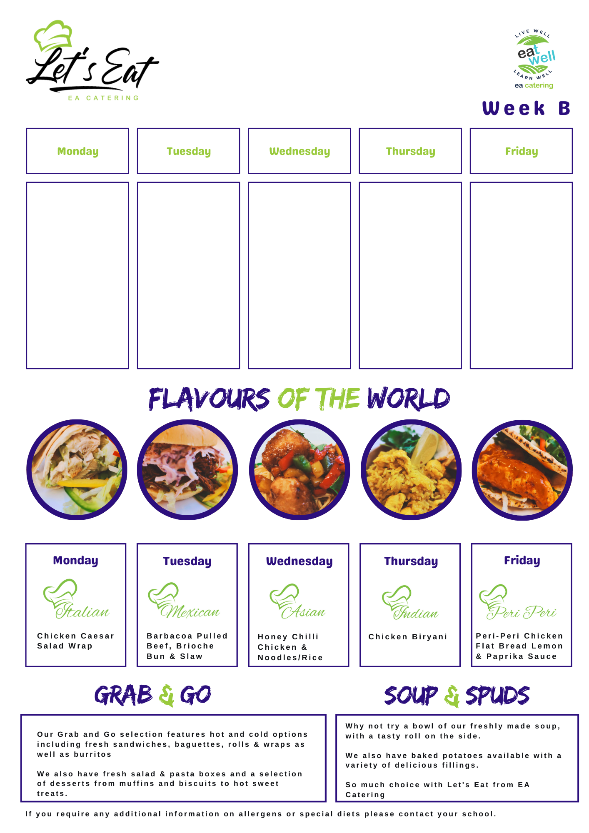
The hub week 4
Pasta & Meatballs
In Creamy Tomato & Herb Sauce
Garlic Bread
Chips
Selection of freshly made Tray bakes
Loaded Chiili Beef Nachos
Breaded Fish Goujons
Baby Boils
Peas
Selection of freshly made Tray bakes
Hot Dog
Caramelized Onions
Chips
Selection of freshly made Tray bakes
Steak Pie
Baby Boils
Cauliflower cheese
Selection of freshly made Tray bakes
Chicken Curry, Steamed Rice
Naan Bread
Selection of freshly made Tray bakes

