Slide 1
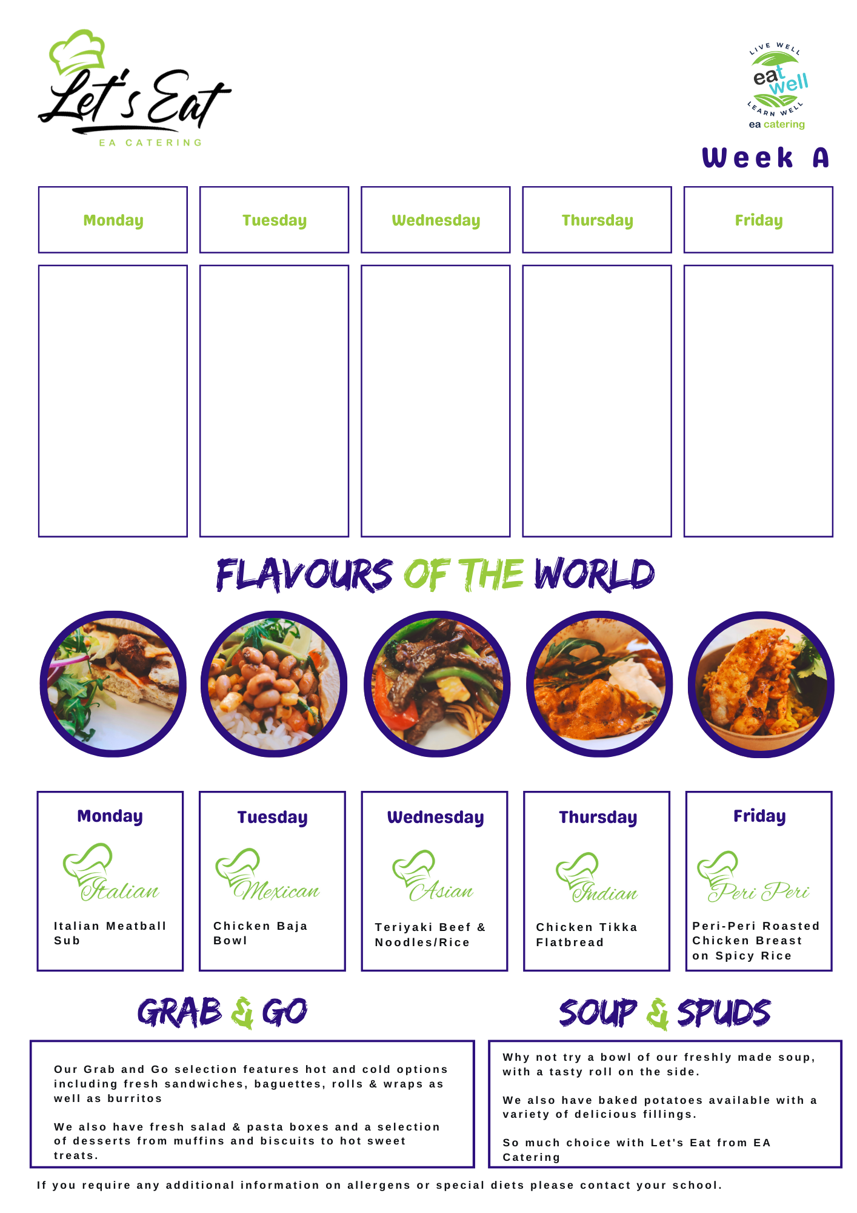
The hub week 1
Crispy Chicken & Cheese wrap
Salad & Coleslaw
Pasta & Sauce
freshly made Tray bakes
Chinese Style Pork with Chilli Noodles
Panko Coated Goujons
Baby Boils
Peas
freshly made Tray bakes
Beef Burger
Chips
Beans
Curry sauce
freshly made Tray bakes
Chicken Curry, Steamed Rice
Chips
Sautéed Peas & Onions
freshly made Tray bakes
Lasagne
Garlic Bread, salad & Coleslaw
freshly made Tray bakes

Slide 2
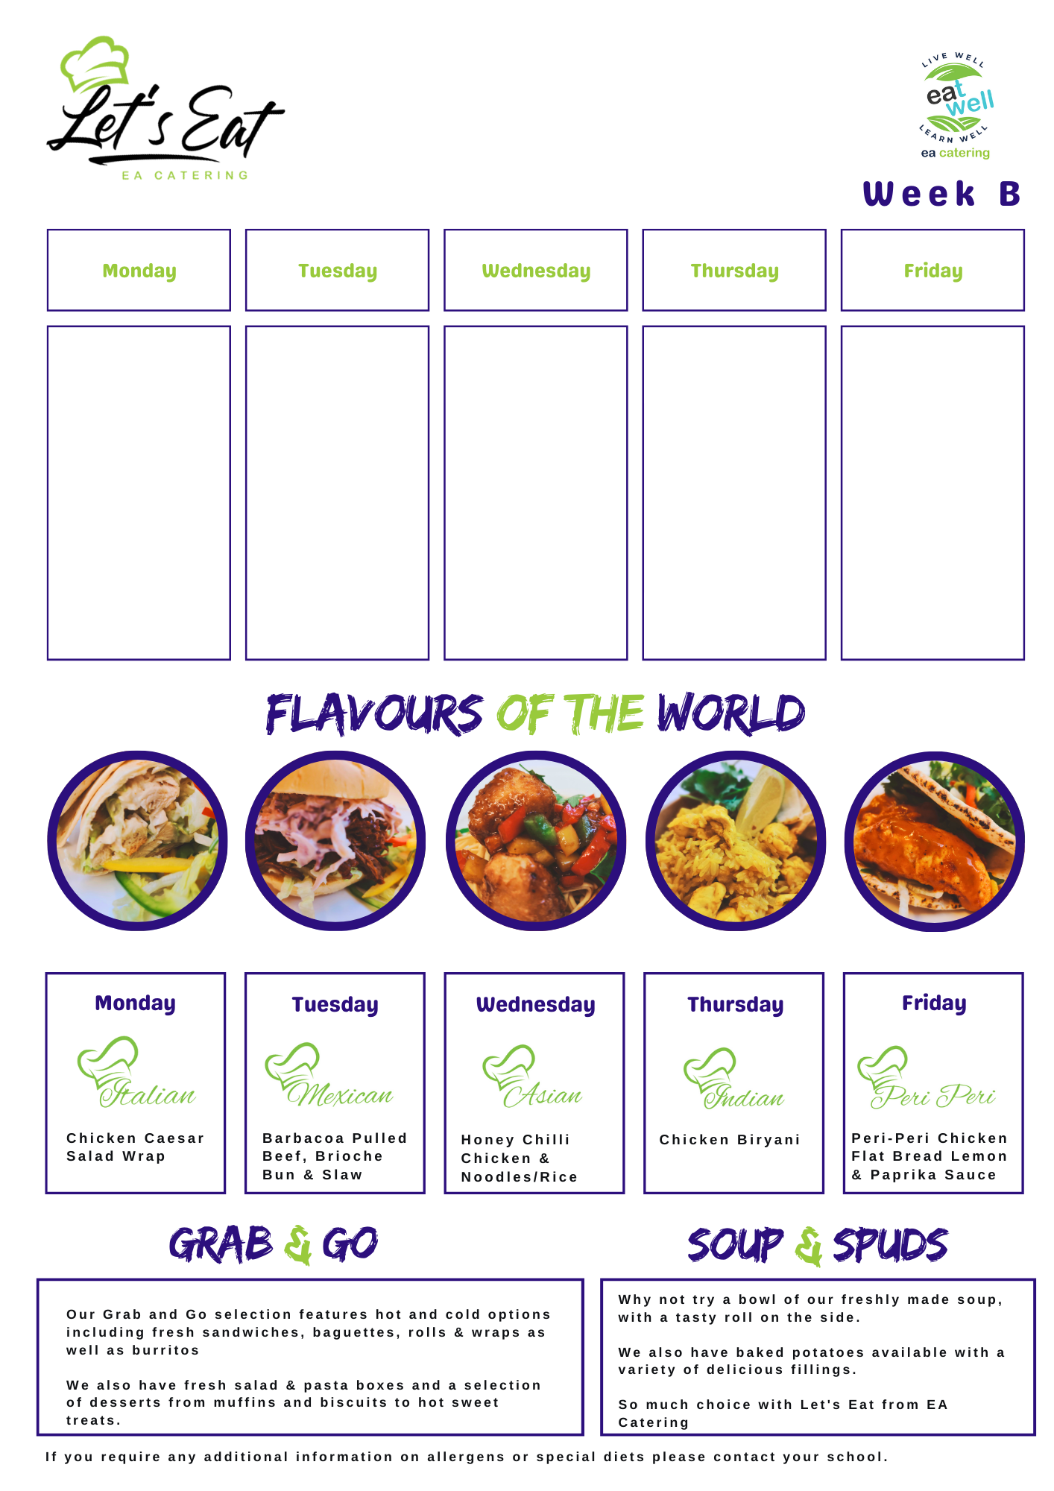
The hub week 2
Katsu Curry
Steamed Rice
Selection of freshly made Tray bakes
Sausages
Mash
Beans
Crusty Bread
Selection of freshly made Tray bakes
Pasta Bake
Garlic Bread
Chips
Curry Sauce
Selection of freshly made Tray bakes
Steak Pie
Baby Boils
Peas
Selection of freshly made Tray bakes
Chicken Curry, Steamed Rice
Chips
Selection of freshly made Tray bakes

